Slide 1

The Graphics Rendering Pipeline

Slide 2
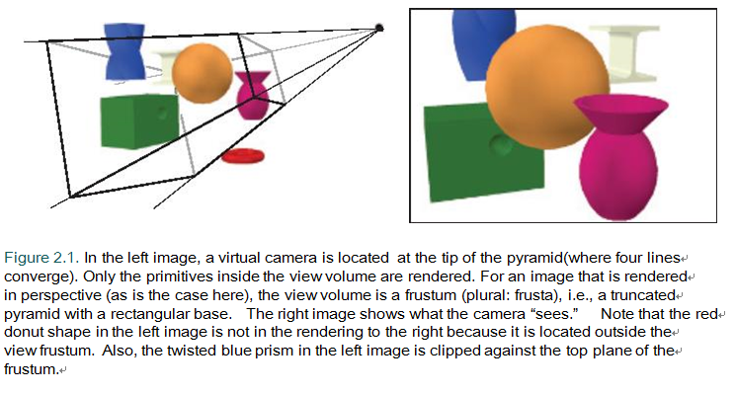
The main function of the pipeline is to generate, or render, a two-dimensional image, given a virtual camera, three-dimensional objects, light sources, and more. The rendering pipeline is thus the underlying tool for real-time rendering. The locations and shapes of the objects in the image are determined by their geometry, the characteristics of the environment, and the placement of the camera in that environment. The appearance of the objects is aﬀected by material properties,light sources,textures(images applied to surfaces),and shading equations.

Slide 3
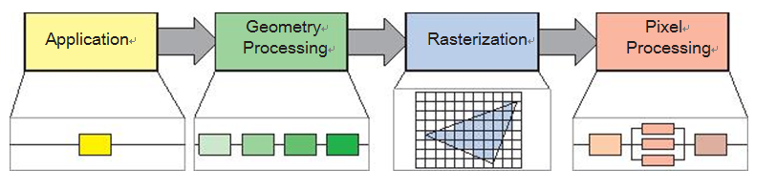
1 Architecture
The basic construction of the rendering pipeline, consisting of four stages: application, geometry processing, rasterization, and pixel processing. Each of these stages may be a pipeline in itself, as illustrated below the geometry processing stage, or a stage may be (partly) parallelized, as shown below the pixel processing stage. In this illustration,the application stage is a single process, but this stage could also be pipelined or parallelized. Note that rasterization ﬁnds the pixels inside a primitive,e.g.,a triangle.

Slide 4
2 The Application Stage
The developer has full control over what happens in the application stage, since it usually executes on the CPU.
At the end of the application stage, rendering primitives, i.e., points, lines, and triangles is fed to the geometry stage. This is the most important task of the application stage.
One process commonly implemented in this stage is collision detection. After a collision is detected between two objects, a response may be generated and sent back to the colliding objects, as well as to a force feedback device. Acceleration algorithms, such as particular culling algorithms are also implemented here.
The application stage is also the place to take care of input from other sources, such as the keyboard, the mouse, a head-mounted display.

Slide 5
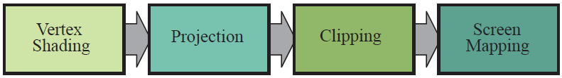
3 Geometry Processing
The geometry processing stage on the GPU is responsible for the most of the per-polygon and per-vertex operations.
This stage is further divided into the following functional stages: vertex shading, projection, clipping, and screen mapping

Slide 6
3.1 Vertex Shading
There are two main tasks of vertex shading, namely, to compute the position for a vertex and to evaluate whatever the programmer may like to have as vertex output data, such as a normal and texture coordinates.
Traditionally much of the shade of an object was computed by applying lights to each vertex’s location and normal and storing only the resulting color at the vertex. These colors were then interpolated across the triangle.
With the advent of the modern GPU, along with some or all of the shading taking place per pixel, this vertex shading stage is more general and may not evaluate any shading equations at all, depending on the programmer’s intent. The vertex shader is now a more general unit dedicated to setting up the data associated with each vertex. As an example, the vertex shader can animate an object.

Slide 7
3.1 Vertex Shading
We start by describing how the vertex position is computed, a set of coordinates that is always required. On its way to the screen, a model is transformed into several diﬀerent spaces or coordinate systems.
It is the vertices and the normals of the model that are transformed by the model transform. The coordinates of an object are called model coordinates, and after the model transform has been applied to these coordinates, the model is said to be located in world coordinates or in world space.

Slide 8
3.1 Vertex Shading
only the models that the camera (or observer) sees are rendered. The camera has a location in world space and a direction, which are used to place and aim the camera. To facilitate projection and clipping, the camera and all the models are transformed with the view transform. The purpose of the view transform is to place the camera at the origin and aim it, to make it look in the direction of the negative z-axis, with the y-axis pointing upward and the x-axis pointing to the right.

Slide 9
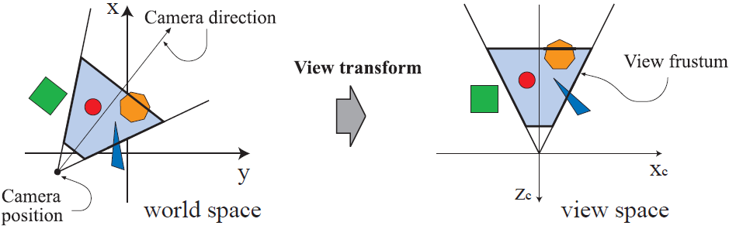
3.1 Vertex Shading
In the left illustration, a top-down view shows the camera located and oriented as the user wants it to be, in a world where the +z-axis is up. The view transform reorients the world so that the camera is at the origin, looking along its negative z-axis, with the camera’s +y-axis up, as shown on the right. This is done to make the clipping and projection operations simpler and faster.The light blue area is the view volume. Here, perspective viewing is assumed, since the view volume is a frustum. Similar techniques apply to any kind of projection.

Slide 10
3.1 Vertex Shading
Next, we describe the second type of output from vertex shading. To produce a realistic scene, it is not sufficient to render the shape and position of objects, but their appearance must be modeled as well.
This description includes each object’s material, as well as the eﬀect of any light sources shining on the object. Materials and lights can be modeled in a number of ways, from simple colors to elaborate representations of physical descriptions.

Slide 11
3.1 Vertex Shading
This operation of determining the effect of a light on a material is known as shading. It involves computing a shading equation at various points on the object.
A variety of material data can be stored at each vertex, such as the point's location, a normal, a color, or any other numerical information that is needed to compute the shading equation. Vertex shading results (which can be colors, vectors, texture coordinates, or any other kind of shading data) are then sent to the rasterization and pixel processing stage to be interpolated and used to compute the shading of the surface.

Slide 12
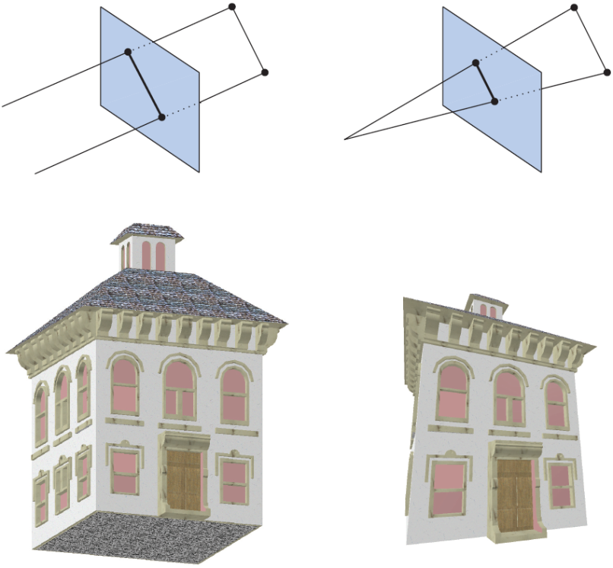
3.2 Projection
As part of vertex shading, rendering systems perform projection and then clipping, which transforms the view volume into a unit cube with its extreme points at (-1,-1,-1) and (1,1, 1). The unit cube is called the canonical view volume. Projection is done ﬁrst, and on the GPU it is done by the vertex shader. There are two commonly used projection methods, namely orthographic (also called parallel) and perspective projection.

Slide 13
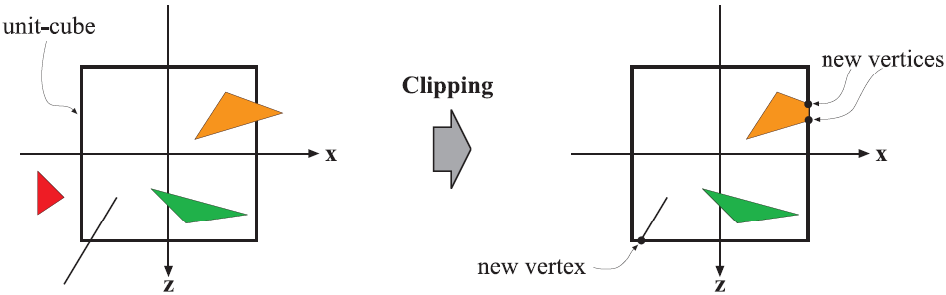
3.3 Clipping
It is the primitives that are partially inside the view volume that require clipping. The clipping step uses the 4-value homogeneous coordinates produced by projection to perform clipping. Values do not normally interpolate linearly across a triangle in perspective space. The fourth coordinate is needed so that data are properly interpolated and clipped when a perspective projection is used. Finally, perspective division is performed, which places the resulting triangles’ positions into three-dimensional normalized device coordinates. As mentioned earlier, this view volume ranges from (−1,−1,−1) to (1,1,1). The last step in the geometry stage is to convert from this space to window coordinates.

Slide 14
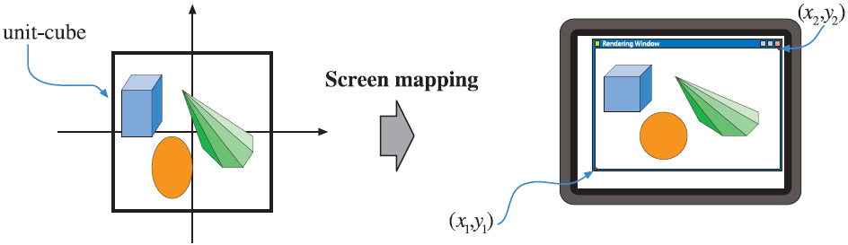
3.4 Screen Mapping
Only the (clipped) primitives inside the view volume are passed on to the screen mapping stage, and the coordinates are still three dimensional when entering this stage. The x- and y-coordinates of each primitive are transformed to form screen coordinates.
Screen coordinates together with the z-coordinates are also called window coordinates. screen coordinates. along with the z-coordinate (-1 < z < 1), are passed on to the rasterizer stage.

Slide 15
4 Rasterization
Given the transformed and projected vertices with their associated shading data (all from geometry processing), the goal of the next stage is to ﬁnd all pixels—short for picture elements—that are inside the primitive, e.g., a triangle, being rendered.
This process is called rasterization or scan conversion, which is thus the conversion from two-dimensional vertices in screen space—each with a z-value (depth value) and various shading information associated with each vertex—into pixels on the screen.

Slide 16
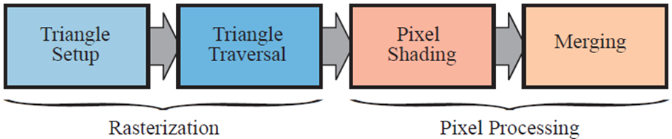
4 Rasterization
Triangle Setup
In this stage the diﬀerentials, edge equations, and other data for the triangle are computed. These data may be used for triangle traversal as well as for interpolation of the various shading data produced by the geometry stage. Fixed-function hardware is used for this task.
Triangle Traversal
Here is where each pixel that has its center (or a sample) covered by the triangle is checked and a fragment generated for the part of the pixel that overlaps the triangle. Finding which samples or pixels are inside a triangle is often called triangle traversal. Each triangle fragment’s properties are generated using data interpolated among the three triangle vertices.

Slide 17
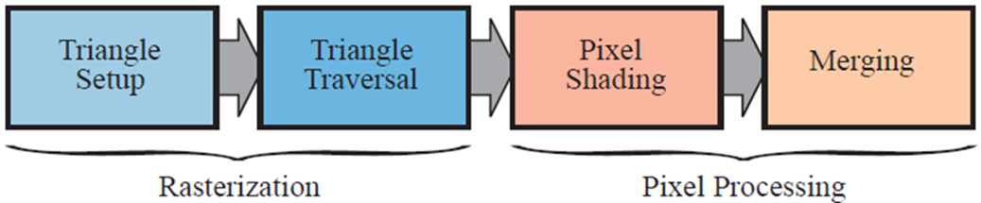
5 Pixel Processing
At this point, all the pixels that are considered inside a triangle or other primitive have been found as a consequence of the combination of all the previous stages. The pixel processing stage is divided into pixel shading and merging. Pixel processing is the stage where per-pixel or per-sample computations and operations are performed on pixels or samples that are inside a primitive.

Slide 18
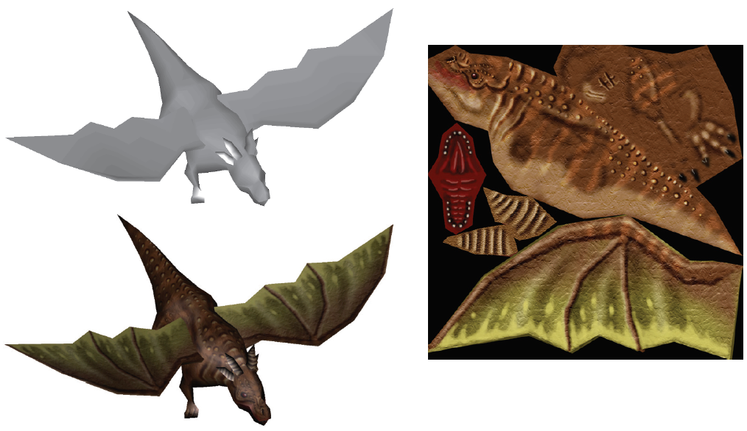
5.1 Pixel Shading
Any per-pixel shading computations are performed here, using the interpolated shading data as input. The pixel shading stage is executed by programmable GPU cores. To that end, the programmer supplies a program for the pixel shader (fragment shader in OpenGL). A large variety of techniques can be employed here, one of the most important of which is texturing, simply means “gluing” one or more images(1D,2D,3D ) onto that object. At its simplest, the end product is a color value for each fragment, and these are passed onto the next sub- stage.

Slide 19
5.1 Merging
The information for each pixel is stored in the color buﬀer, which is a rectangular array of colors(a red, a green, and a blue component for each color). It is the responsibility of the merging stage to combine the fragment color produced by the pixel shading stage with the color currently stored in the buﬀer. This stage is also called ROP, standing for “raster operations (pipeline) ” or “render output unit”. Unlike the shading stage, the GPU subunit that performs this stage is typically not fully programmable. However, it is highly conﬁgurable, enabling various eﬀects.
This stage is also responsible for resolving visibility. This means that when the whole scene has been rendered, the color buﬀer should contain the colors of the primitives in the scene that are visible from the point of view of the camera. For most or even all graphics hardware, this is done with the z-buﬀer(also called depth buﬀer) algorithm.

Slide 20
5.1 Merging
The stencil buﬀer is an oﬀ screen buﬀer used to record the locations of the rendered primitive. It typically contains 8 bits per pixel. Primitives can be rendered into the stencil buﬀer using various functions, and the buﬀer’s contents can then be used to control rendering into the color buﬀer and z-buﬀer. As an example, assume that a ﬁlled circle has been drawn into the stencil buﬀer. This can be combined with an operator that allows rendering of subsequent primitives into the color buﬀer only where the circle is present.
The stencil buﬀer can be a powerful tool for generating some special eﬀects. All these functions at the end of the pipeline are called raster operations (ROP)or blend operations. It is possible to mix the color currently in the color buﬀer with the color of the pixel being processed inside a triangle. This can enable eﬀects such as transparency or the accumulation of color samples.

Slide 21
6 Through the Pipeline
Points, lines, and triangles are the rendering primitives from which a model or an object is built. Imagine that the application is an interactive computer aided design (CAD) application, and that the user is examining a design for a waﬄe maker. Here we will follow this model through the entire graphics rendering pipeline, consisting of the four major stages: application, geometry, rasterization and pixel processing. The scene is rendered with perspective into a window on the screen. In this simple example, the waﬄe maker model includes both lines(to show the edges of parts) and triangles(to show the surfaces). The waﬄe maker has a lid that can be opened. Some of the triangles are textured by a two-dimensional image with the manufacturer’s logo. For this example, surface shading is computed completely in the geometry stage, except for application of the texture, which occurs in the rasterization stage.

Slide 22
6.1 Application
CAD applications allow the user to select and move parts of the model. For example, the user might select the lid and then move the mouse to open it. The application stage must translate the mouse move to a corresponding rotation matrix, then see to It that this matrix is properly applied to the lid when it is rendered.
Another example: An animation is played that moves the camera along a predeﬁned path to show the waﬄe maker from diﬀerent views. The camera parameters, such as position and view direction, must then be updated by the application, dependent upon time. For each frame to be rendered, the application stage feeds the camera position, lighting, and primitives of the model to the next major stage in the pipeline—the geometry stage.

Slide 23
6.2 Geometry Processing
For perspective viewing, we assume here that the application has supplied a projection matrix. Also, for each object, the application has computed a matrix that describes both the view transform and the location and orientation of the object in itself. In our example, the waﬄe maker’s base would have one matrix, the lid another. In the geometry stage the vertices and normals of the object are transformed with this matrix, putting the object into view space. Then shading or other calculations at the vertices may be computed, using material and light source properties. Projection is then performed using a separate user-supplied projection matrix, transforming the object into a unit cube’s space that represents what the eye sees. All primitives outside the cube are discarded. All primitives intersecting this unit cube are clipped against the cube in order to obtain a set of primitives that lies entirely inside the unit cube . The vertices then are mapped into the window on the screen. After all these per-triangle and per-vertex operations have been performed, the resulting data are passed onto the rasterization stage.

Slide 24
6.3 Rasterization
All the primitives that survive clipping in the previous stage are then rasterized, which means that all pixels that are inside a primitive are found and sent further down the pipeline to pixel processing.

Slide 25
6.4 Pixel Processing
The goal here is to compute the color of each pixel of each visible primitive. Those triangles that have been associated with any textures(images) are rendered with these images applied to them as desired. Visibility is resolved via the z-buﬀer algorithm, along with optional discard and stencil tests. Each object is processed in turn, and the ﬁnal image is then displayed on the screen.

Slide 26
Conclusion
This pipeline resulted from decades of API and graphics hardware evolution targeted to real-time rendering applications. It is important to note that this is not the only possible rendering pipeline; oﬄine rendering pipelines have undergone diﬀerent evolutionary paths. Rendering for ﬁlm production was often done with micro polygon pipelines but ray tracing and path tracing have taken over lately. These techniques, may also be used in architectural and design pre visualization.
For many years, the only way for application developers to use the process described here was through a ﬁxed-function pipeline deﬁned by the graphics API in use. The ﬁxed-function pipeline is so named because the graphics hardware that implements it consists of elements that can not be programmed in a ﬂexible way. The last example of a major ﬁxed-function machine is Nintendo’s Wii, introduced in 2006. Programmable
GPUs, on the other hand, make it possible to determine exactly what operations are applied in various sub-stages throughout the pipeline.

